Slide 1
ECE 6730 Project Presentation
Coffee Shop Simulation
Leslie Brown
28 April 2010

Slide 2
Project Goals
Create model of coffee shop
Customer arrivals (FIFO queue)
Registers serving customers
Baristas making drinks
Customers
Choose baseline and characterize store performance metrics
Average customer wait time
Average order to delivery time
Peak register line length
# lost customers
Employee idle time
Use model to simulate various operational scenarios
# cashiers, # tables, # baristas
Evaluate resulting store performance metrics for varying operational scenarios, compare to baseline
Improve my understanding of simulating activities (all prior software development done with either discrete time-stepped simulations, physical single-agent systems, e.g. bullet trajectories)

Slide 3
Coffee Shop Model
Drink group
Register 1
Register 2
Register Queue
Table Group

Slide 4
Customer Arrivals
Customer inter-arrival times drawn from exponentially distributed random variable with piece-wise constant mean μ
Shop is busiest in the morning and evening (peak at about 60 customers/hour) and slowest in the late afternoon
Shop is closed between 10pm and 6am

Slide 5
Customer Life Cycle
Arrives at shop, waits in FIFO queue for a free register
Randomly defined as “take-out” or “stay-in” upon arrival
If queue > 20 people, customer balks
Moves to register to place order
Ordering takes U(1,2) minutes
Moves to drink group to wait for drink
Drink preparation takes U(m₁,m₂) minutes, where m₁,m₂ are a function of # baristas
Number Baristas | Min Drink Prep Time (m₁) | Max Drink Prep Time (m₂)
1 | 2 min | 6 min
2 | 1.5 min | 5 min
3 | 1 min | 4 min

Slide 6
Customer Life Cycle (cont.)
If “stay-in” and a table is available, sits at table. Otherwise, leaves store
T_{stay} chosen upon sitting, U(5,60) minutes
If still re-order conditions are met, orders another drink.
If crowd-out conditions are met, leaves store
If max stay time conditions are met, leaves store

Slide 7
Customer Behavior
Re-order conditions:
Customer has been at table > 30 minutes
register line contains less than 3 people
Crowd-out conditions:
Customers has been at table for > 30 minutes
Register line length + drink line length > 10 people
Balk conditions:
Register line contains > 20 people
Max stay time conditions:
Customer has been at table > t_{stay} (decided upon sitting, U(5,60) minutes)

Slide 8
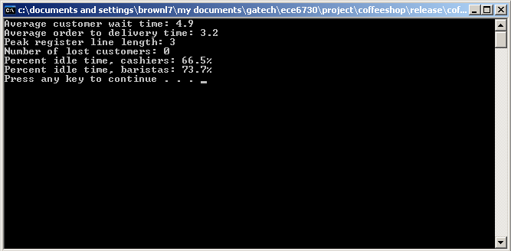
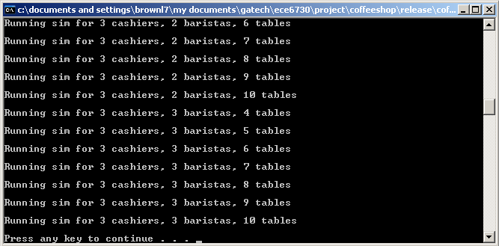
Implementation
C++ console application
Single and batch modes →
Simulation provides previously discussed performance metrics for user-defined input parameters

Slide 9
Preliminary Results
Intermediate output statistics to evaluate is model is behaving realistically

Slide 10
Preliminary Results
Simulated baseline
2 cashiers, 2 baristas, 6 tables
Simulated various deviations from baseline
# cashiers = [1 2 3]
# baristas = [1 2 3]
# tables = [4 6 8 10]
Cashiers | Baristas | Tables | Avg Reg Wait | Avg Drink Wait | Peak Reg Line | Lost customers | Cashier % idle time | Barista % idle time
1 | 1 | 4 | 15.81139 | 3.974943 | 21 | 25 | 0.349698 | 0.814361
1 | 1 | 6 | 14.39484 | 4.051052 | 21 | 15 | 0.312468 | 0.85137
1 | 1 | 8 | 17.56531 | 4.022442 | 21 | 29 | 0.312064 | 0.82153
1 | 1 | 10 | 16.16237 | 4.096446 | 21 | 24 | 0.292431 | 0.834147
1 | 2 | 4 | 18.76285 | 3.257236 | 21 | 37 | 0.299548 | 0.818842
1 | 2 | 6 | 16.94224 | 3.358911 | 21 | 33 | 0.289412 | 0.833238
1 | 2 | 8 | 16.71619 | 3.240279 | 21 | 46 | 0.297853 | 0.834104
1 | 2 | 10 | 16.15966 | 3.275058 | 21 | 51 | 0.330716 | 0.809767
1 | 3 | 4 | 12.98888 | 2.513035 | 21 | 1 | 0.347695 | 0.776164
1 | 3 | 6 | 17.01679 | 2.483516 | 21 | 32 | 0.340691 | 0.798081
1 | 3 | 8 | 14.92481 | 2.573546 | 21 | 34 | 0.308598 | 0.769804
1 | 3 | 10 | 14.59835 | 2.511178 | 21 | 39 | 0.353903 | 0.780377
2 | 1 | 4 | 5.849467 | 4.069831 | 5 | 0 | 0.634551 | 0.726872
2 | 1 | 6 | 5.778016 | 4.002014 | 5 | 0 | 0.647329 | 0.748442
2 | 1 | 8 | 5.939995 | 4.087262 | 8 | 0 | 0.642107 | 0.76422
2 | 1 | 10 | 5.695267 | 3.945316 | 5 | 0 | 0.654288 | 0.744145
2 | 2 | 4 | 5.045999 | 3.311014 | 4 | 0 | 0.639983 | 0.73073
2 | 2 | 6 | 5.132746 | 3.226617 | 6 | 0 | 0.630859 | 0.755954
2 | 2 | 8 | 5.080697 | 3.252239 | 6 | 0 | 0.661185 | 0.705215
2 | 2 | 10 | 5.029648 | 3.287059 | 4 | 0 | 0.622861 | 0.755251
2 | 3 | 4 | 4.475199 | 2.482505 | 7 | 0 | 0.59404 | 0.725594
2 | 3 | 6 | 4.988419 | 2.526396 | 12 | 0 | 0.602113 | 0.723408
2 | 3 | 8 | 4.432953 | 2.472329 | 7 | 0 | 0.639468 | 0.697638
2 | 3 | 10 | 4.393243 | 2.476626 | 8 | 0 | 0.652146 | 0.695315
3 | 1 | 4 | 5.528115 | 3.993044 | 3 | 0 | 0.76507 | 0.738032
3 | 1 | 6 | 5.628798 | 4.070673 | 4 | 0 | 0.743329 | 0.755993
3 | 1 | 8 | 5.506555 | 3.968861 | 3 | 0 | 0.749969 | 0.735644
3 | 1 | 10 | 5.494464 | 3.940489 | 3 | 0 | 0.765724 | 0.722479
3 | 2 | 4 | 4.7857 | 3.217387 | 3 | 0 | 0.748193 | 0.751079
3 | 2 | 6 | 4.801332 | 3.239497 | 4 | 0 | 0.77446 | 0.711183
3 | 2 | 8 | 4.763092 | 3.22698 | 3 | 0 | 0.744778 | 0.712673
3 | 2 | 10 | 4.871137 | 3.30636 | 5 | 0 | 0.742829 | 0.721161
3 | 3 | 4 | 4.102163 | 2.549539 | 3 | 0 | 0.753559 | 0.713529
3 | 3 | 6 | 3.991812 | 2.440579 | 3 | 0 | 0.758126 | 0.663791
3 | 3 | 8 | 4.043113 | 2.500255 | 3 | 0 | 0.747044 | 0.6759
3 | 3 | 10 | 4.037703 | 2.486697 | 4 | 0 | 0.755935 | 0.706146

Slide 11
Remaining Work
Thorough analysis of results
Examine correlation between input parameters and performance metrics
Which performance metrics are the most sensitive?
Why?
Possibly (time permitting)
Make stay-in, take-out a function of time of day
Investigate making stay-time Gaussian rather than uniform (rare cases where someone lingers for hours)

Slide 12
Questions?

